Slide 1

H

Slide 2
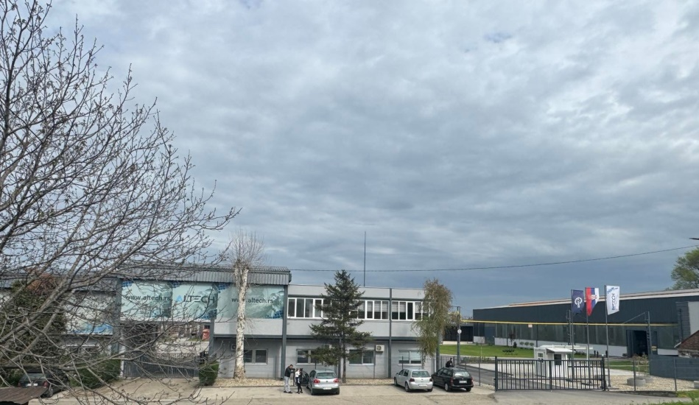
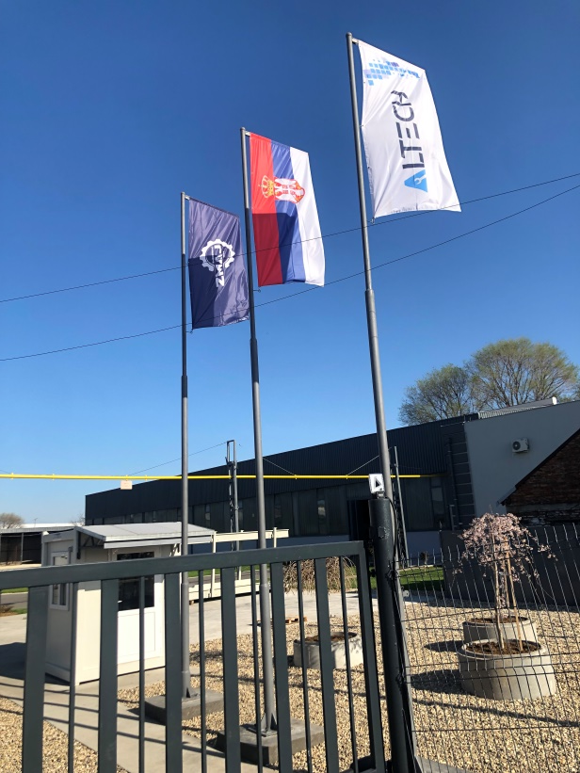

Altech is located in Smederevo on the river Danube, close to the main road, highway, port and railway transshipment point.
Company is located at the very beginning of the industrial zone, and within the Smederevo Free Zone (there are a number of benefits for the company's business with foreign countries).

Slide 3
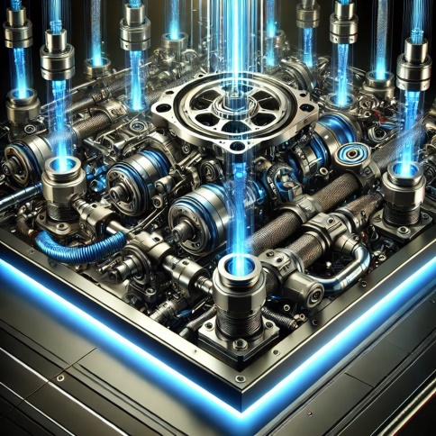
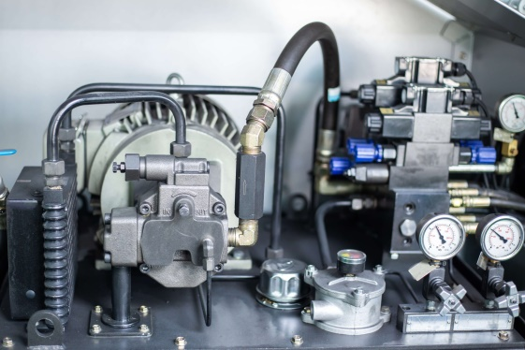
We have been providing our services in hydraulics for over 30 years.
Founded in 1993 under the name Alex Trade, in 2022 the company officially changed name to Altech d.o.o.
With the aim of finding the most technically and commercially optimal solution, Altech is able to supply and install components and systems of the world's largest manufacturers of pneumatic and hydraulic equipment.
The two most important collaborators are Bosh Rexroth and Enerpac.

Slide 4
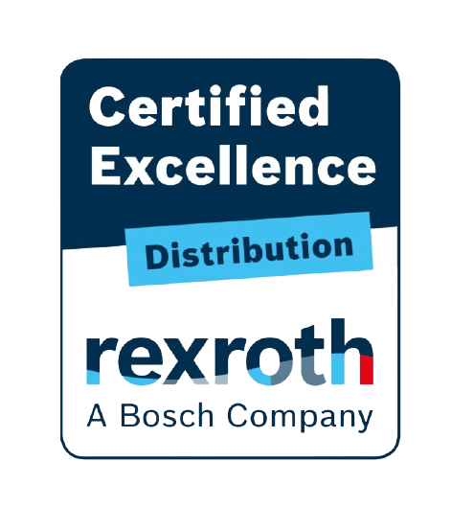
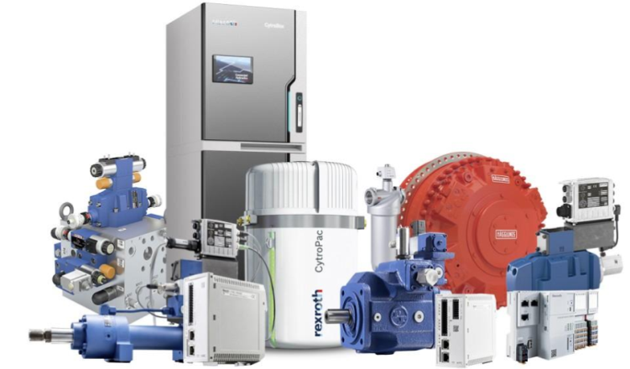


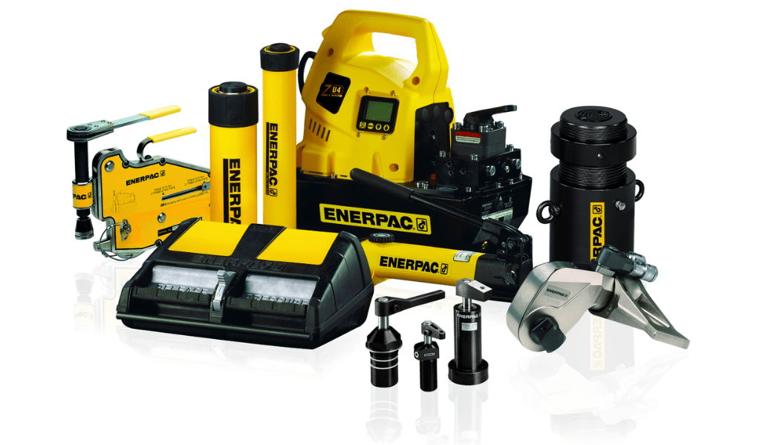
Enerpac is a global market leader in the production of high-pressure hydraulic tools as well as precision heavy-duty positioning systems

Slide 5

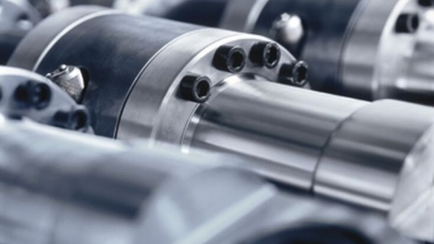
Altech is Bosch Rexroth distributors since 2021.
Bosh Rexroth is global leader in drive and control technologies, providing industrial and mobile automation solutions through hydraulics, electric drives, and other technologies.
Bosh Rexroth in Industrial Hydraulics
Bosh Rexroth offer next generation hydraulic thinking. The latest connected solutions that leverage hydraulic power, while saving space and energy. Allowing new benchmarks to be set for performance, functionality and system lifetime.

Slide 6
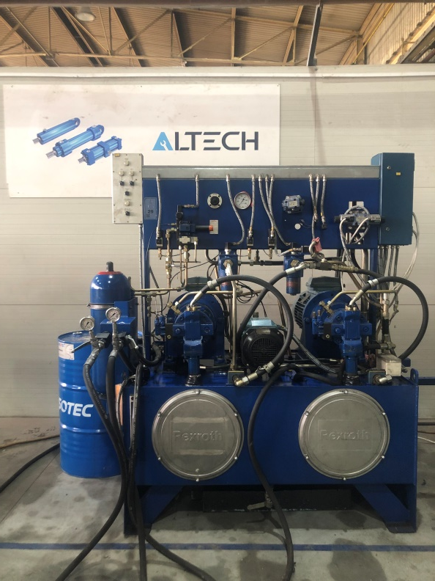
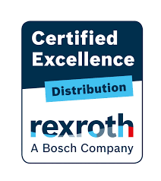

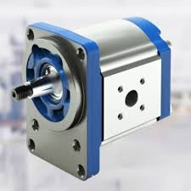
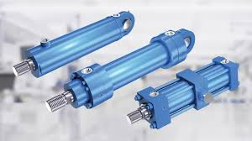
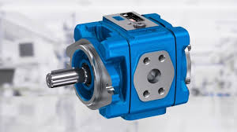
Altech owns Bosch Rexroth aggregate for testing hydraulic cylinders under pressure

Slide 7

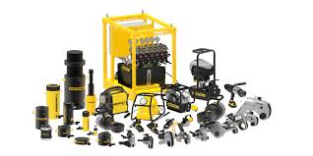
Altech is Enerpac distributors since 2016.
Enerpac is a leading supplier of high pressure hydraulic solutions with a broad product line, local expertise and worldwide distribution network.
Enerpac manufactures high quality tools and solutions with a proven track record of more than 50 years of reliability in a wide range of markets.
Focused on the high pressure hydraulic tool markets.
Innovative products and efficient solutions for practically all industrial applications. A comprehensive range of tools and systems.

Slide 8
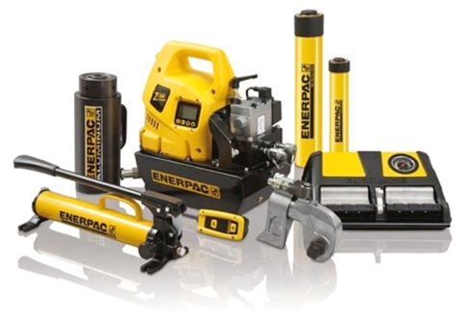
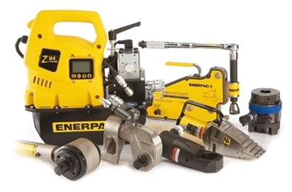
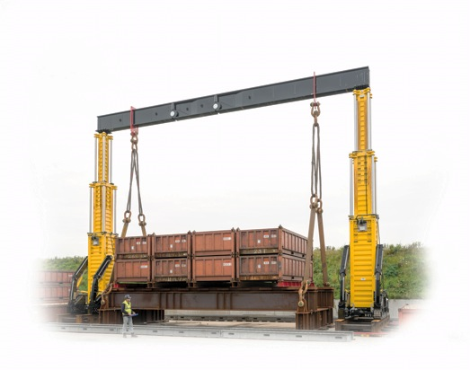
Industrial Tools
Enerpac tools and solutions are used in a wide range of industrial markets and in a wide range of applications.
Bolting Solutions
Enerpac bolting tools take care of the complete bolting workflow ensuring joint integrity in a variety of applications across the industry.
Integrated Solutions
Enerpac Integrated Solutions provides customers with customized solutions, combining hydraulics, steel fabrication and electronic control technology with engineering and application knowledge. This results in innovative hydraulic systems for controlled movement and precise positioning of (heavy) structures.

Slide 9
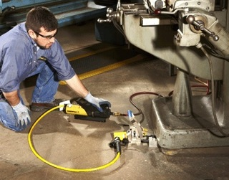
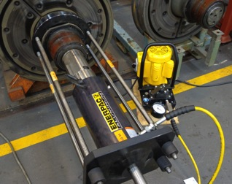
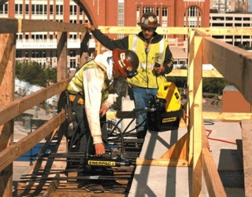
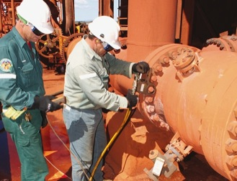
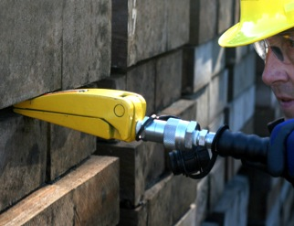
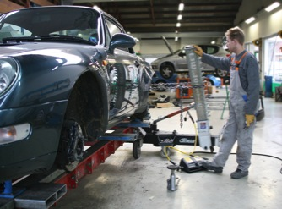
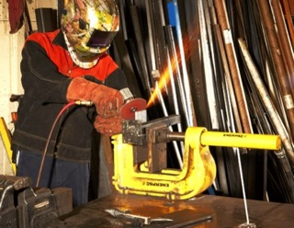
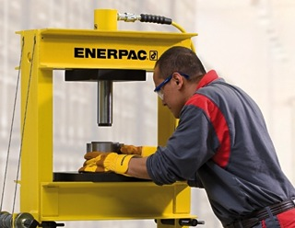
Utilization
Lifting
Pushing & Pulling
Tensioning
Bolting
Spreading
Collision repair
Clamping
Pressing
Notes:
There are infinite possibilities to apply Enerpac’s tools and solutions. These pictures show a few examples of the applications.

Slide 10
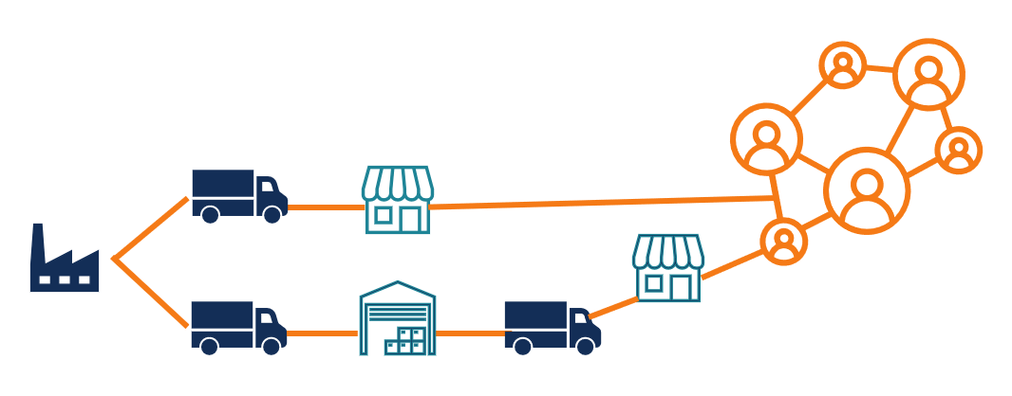

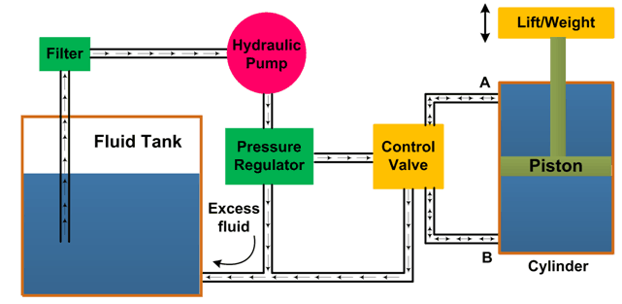
What Altech do:
Distribution
Assembly
Servicing
Technical support
Hydraulic system design
On-site service
Local expertise
Conceptual solutions

Slide 11
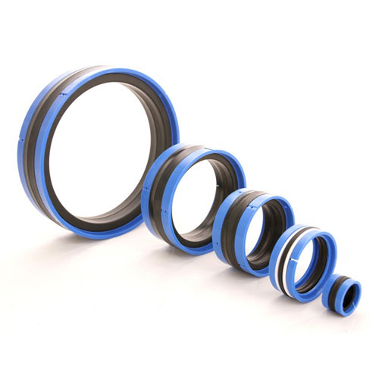
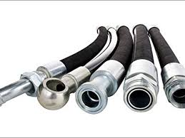
We perform all the above-mentioned pneumatic and hydraulic work on the spot and, if necessary, in our service center.
We have a large stock of spare parts and components from leading manufacturers.
Altech offer you the right solutions and services that will help you get your job done efficiently and safely.
We offer all the additional elements you need to complete your high pressure hydraulic system and get started (hydraulic hoses, seals, couplers ...)

Slide 12
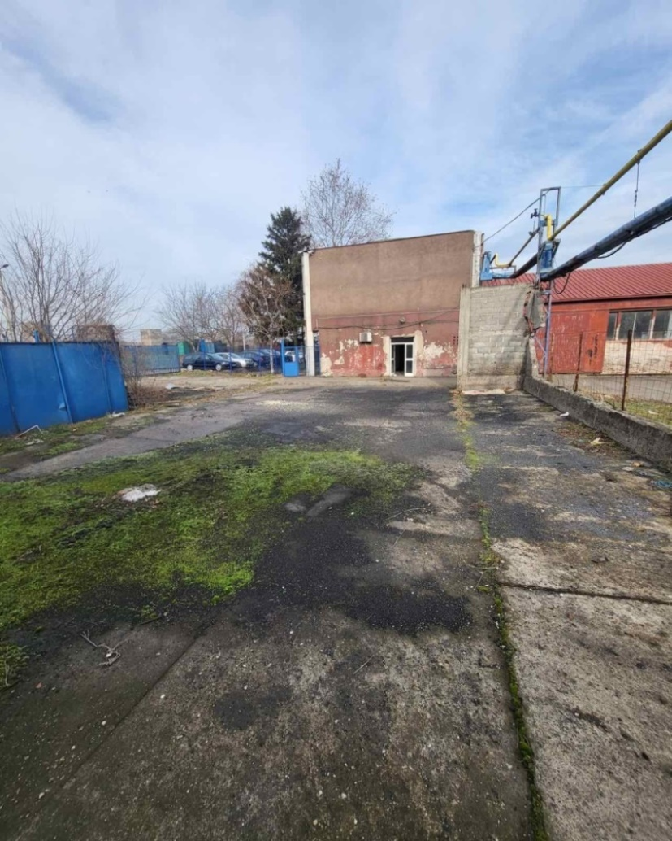
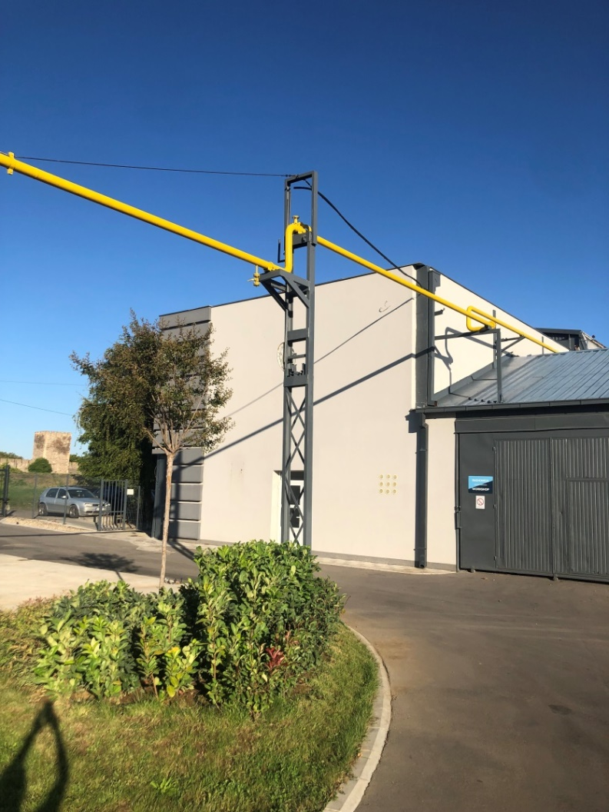
From March 2024, Altech becomes the owner of the company Zmaj d.o.o. in Smederevo.
Zmaj d.o.o. is a leading company in the metal industry.
After taking over the Zmaj d.o.o., Altech reconstructed the factory and its facilities.
Before Now

Slide 13
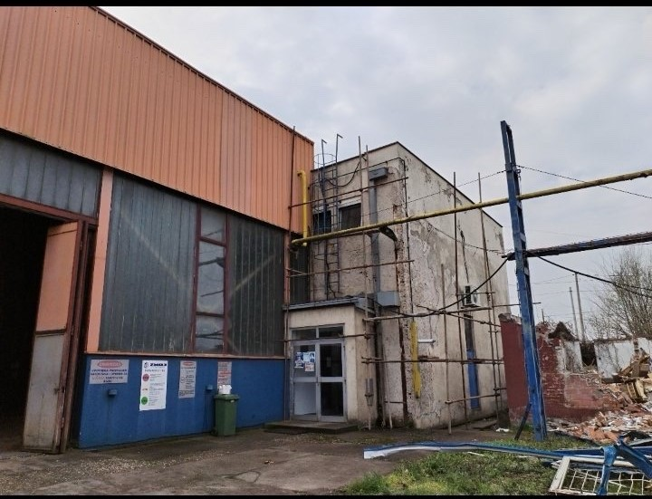
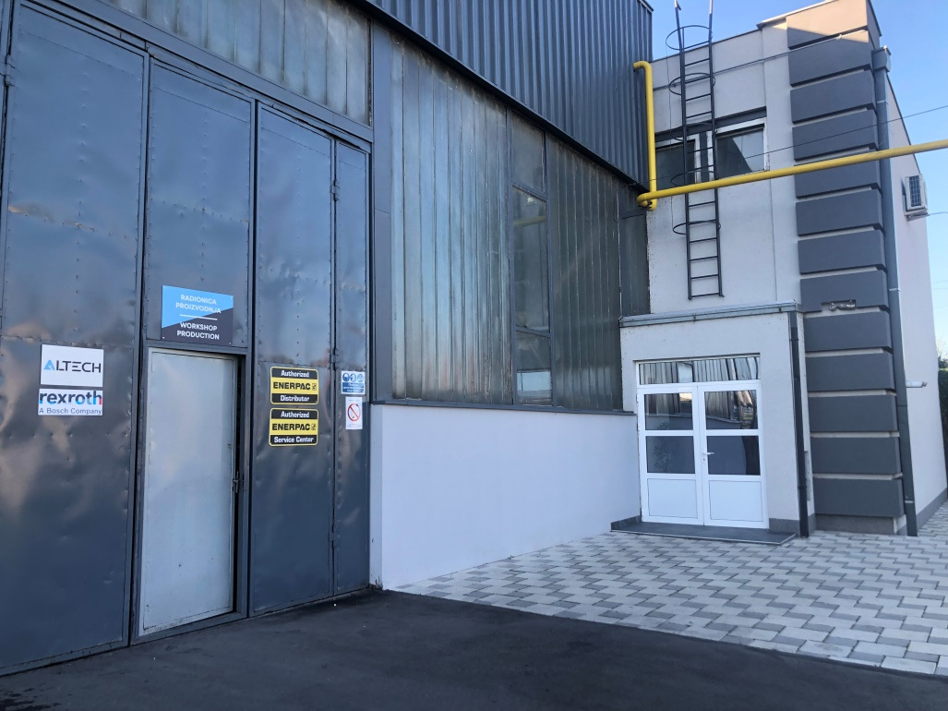
Before Now

Slide 14
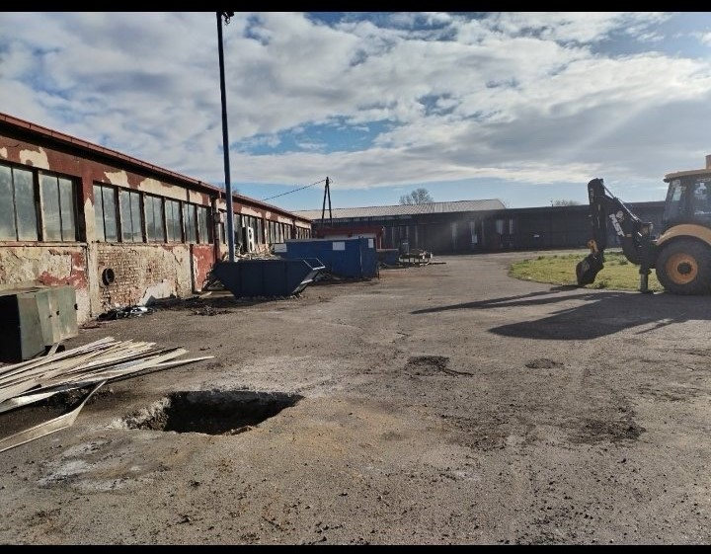
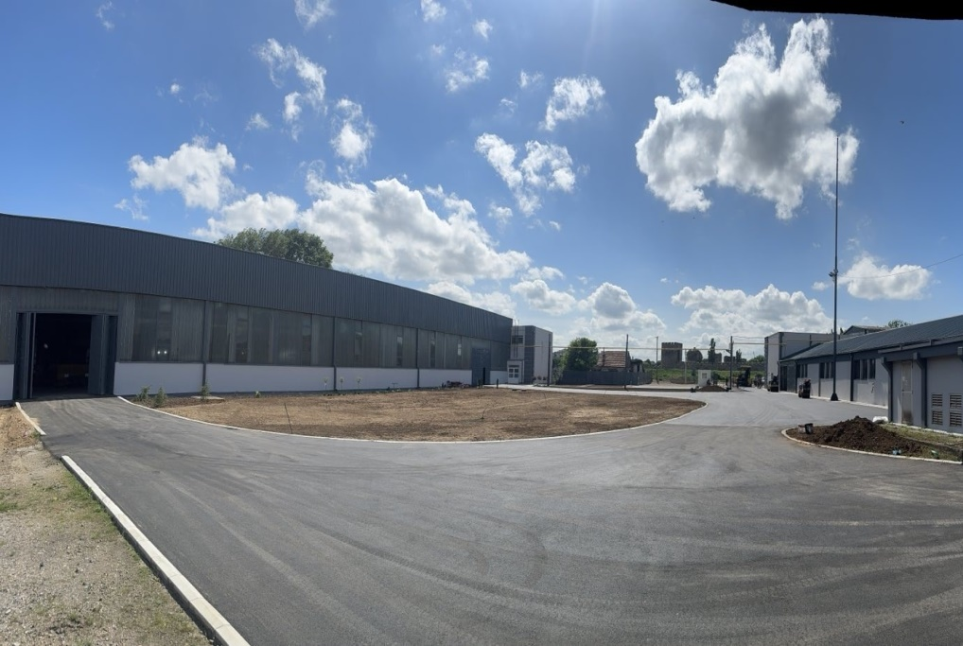
Before
Now

Slide 15
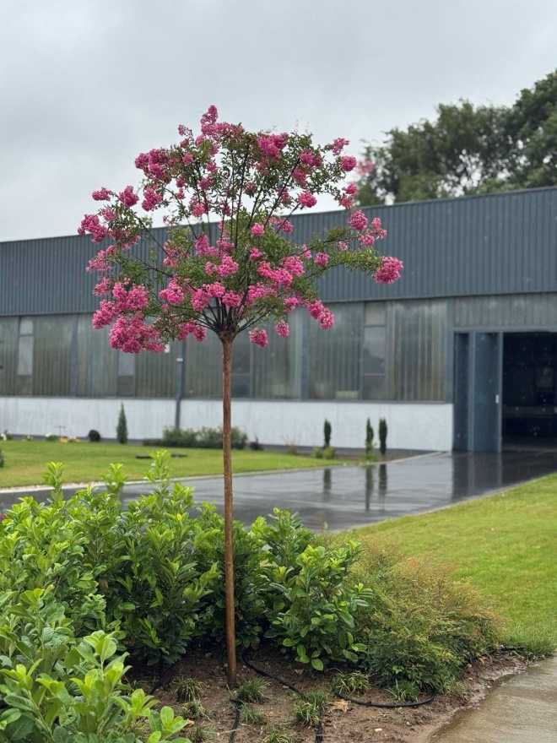
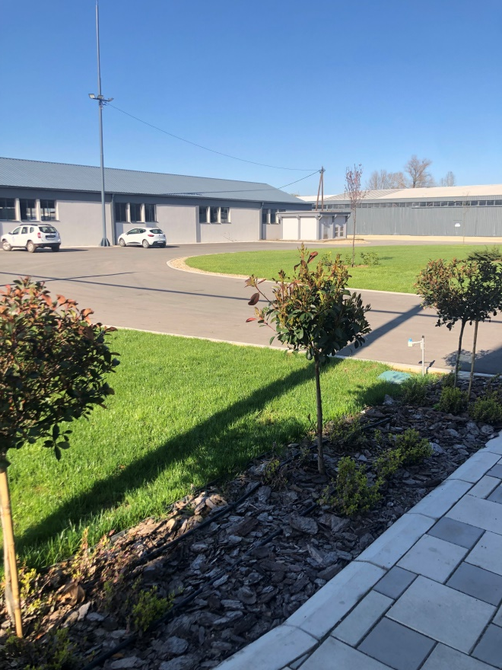
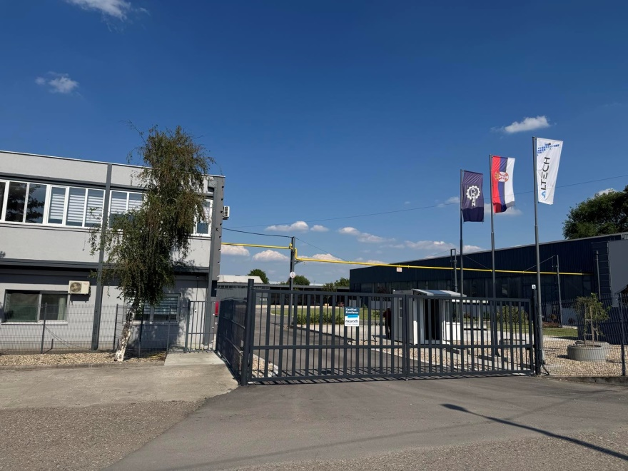

Slide 16
We own high spectrum equipment and machines:
Machines for CNC processing
- production of machine parts by milling (5-axis and 3-axis)
- production of machine parts by turning
CNC deep whole drilling and boring machine
CNC machine for making hydraulic and pneumatic seals
Pipe honing machine
Machine for assembly and disassembly of cylinders
Universal lathes
Furnace for heat treatment
Welding machine

Slide 17
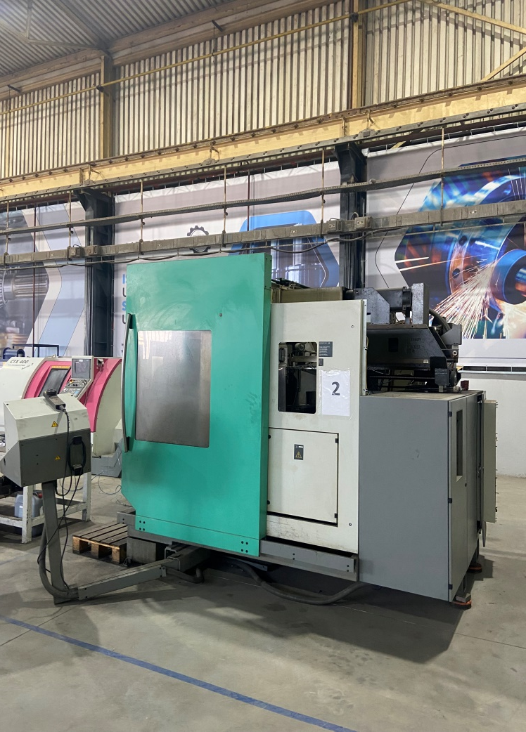
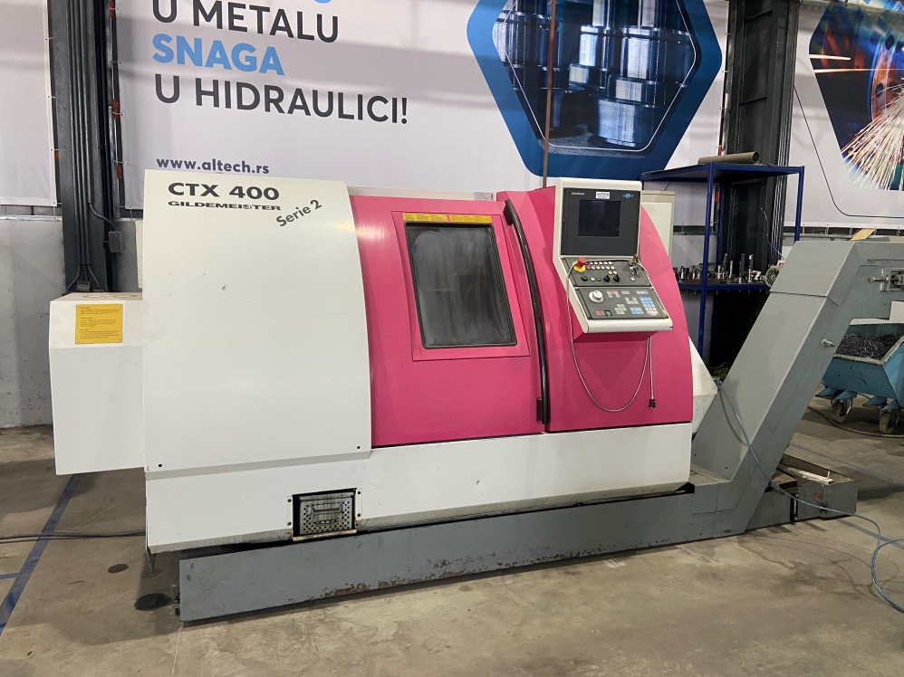
Machines for CNC processing

Slide 18
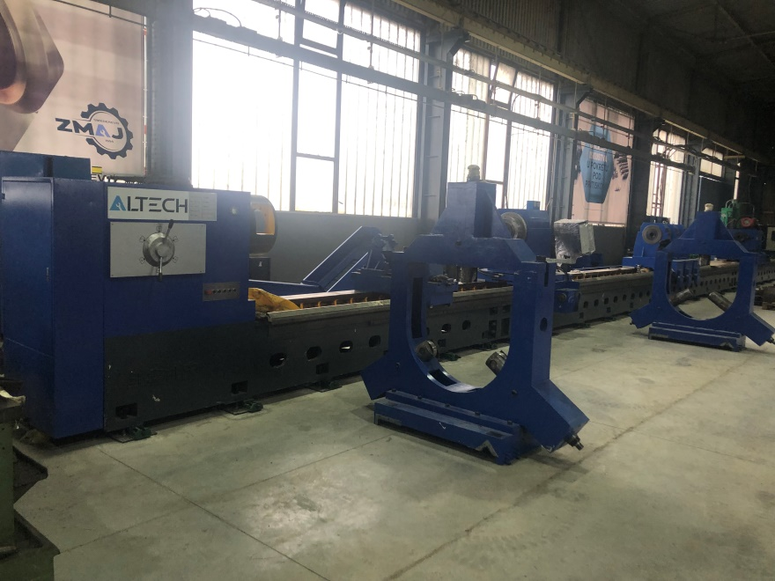
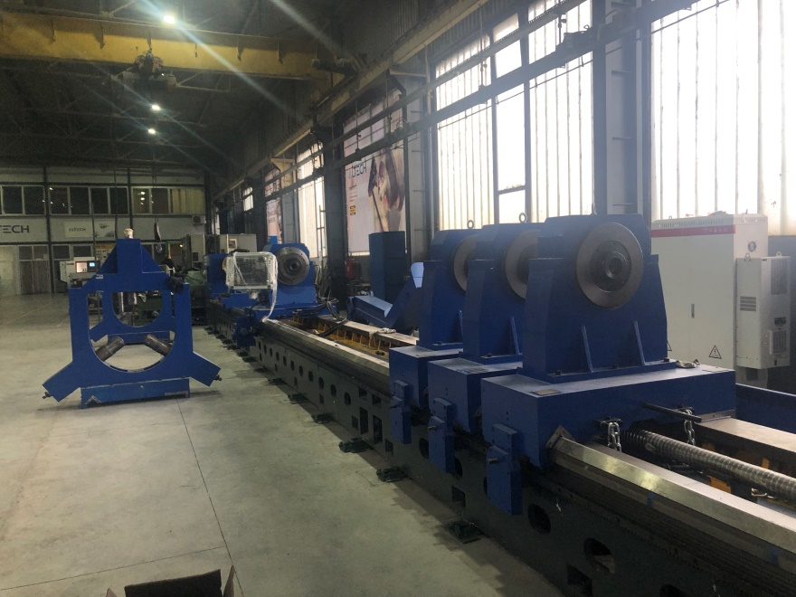
CNC deep whole drilling and boring machine
which can do deep hole drilling till 8m, boring, burnishing and other processing.

Slide 19
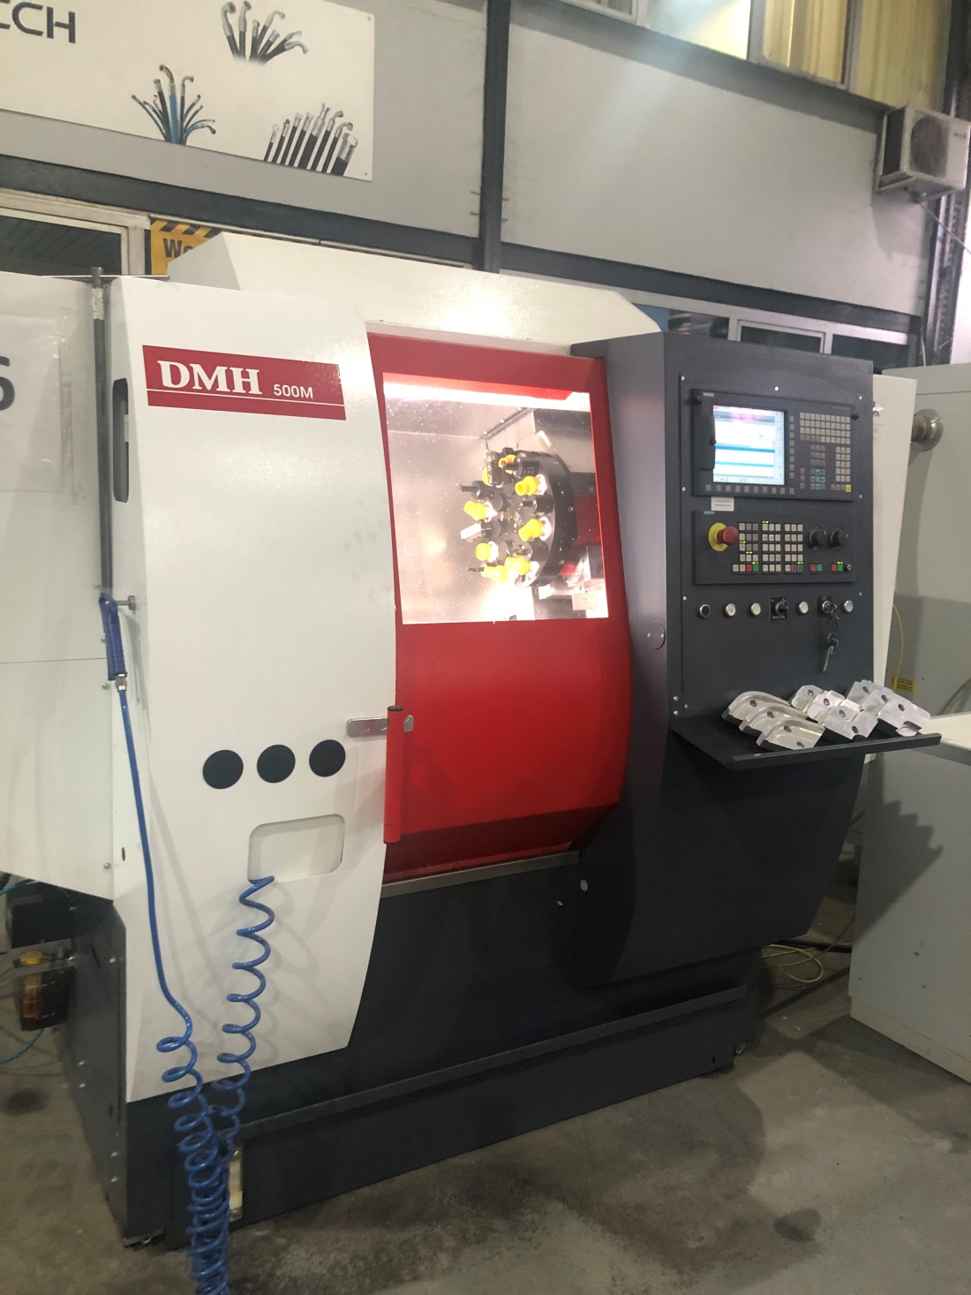
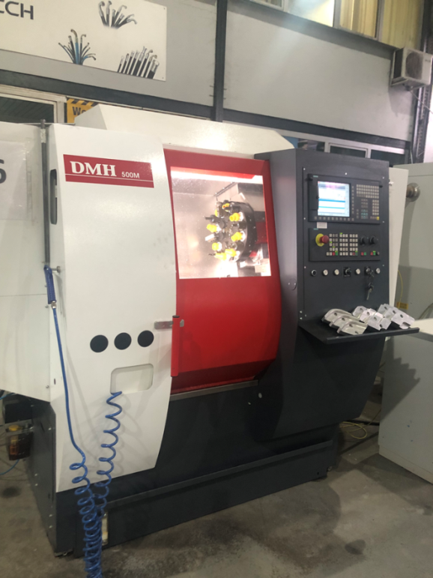
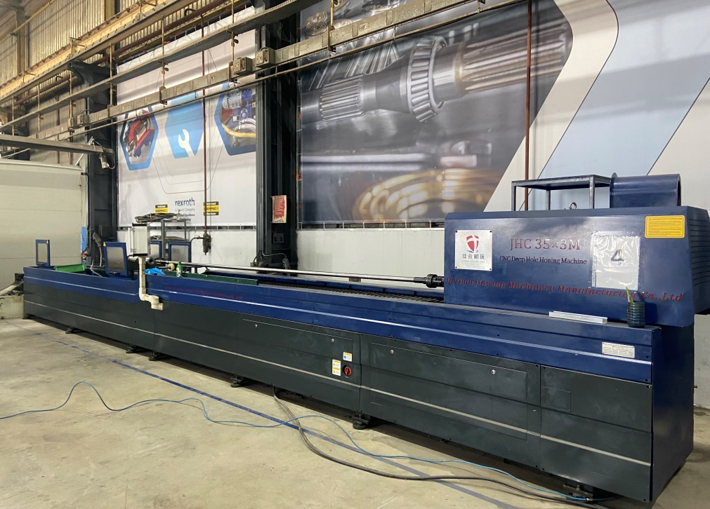
CNC machine for making hydraulic and pneumatic seals
  Pipe honing machine

Slide 20
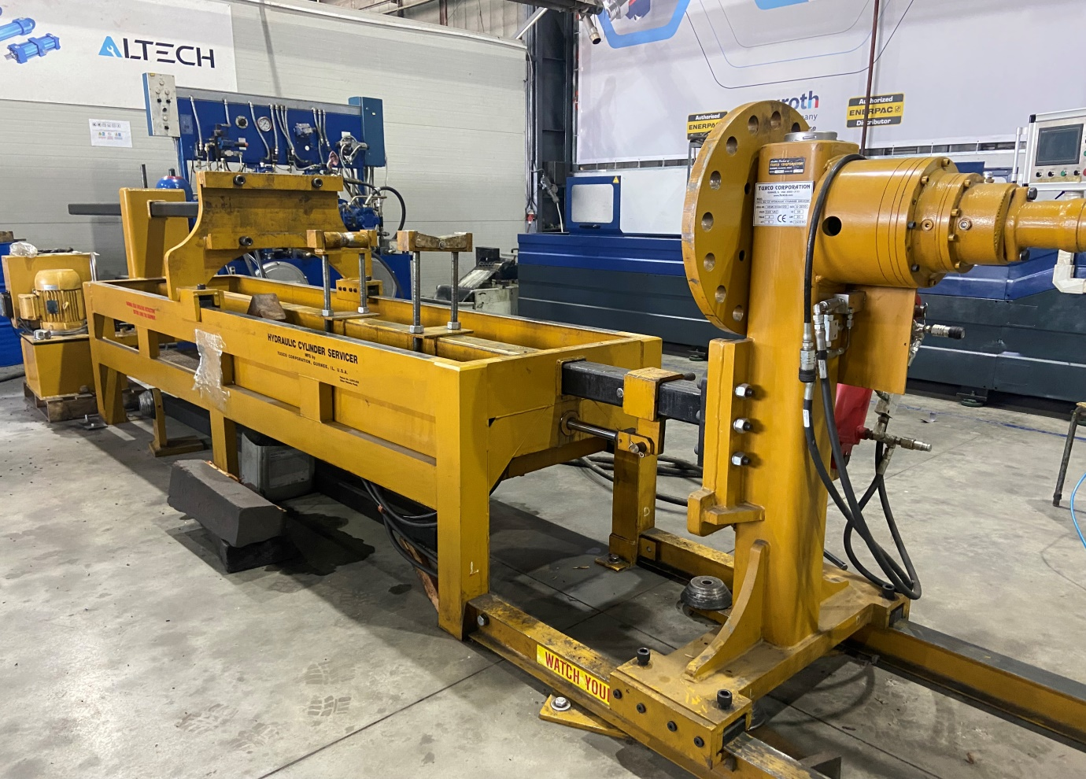
Machine for assembly and disassembly of cylinders

Slide 21
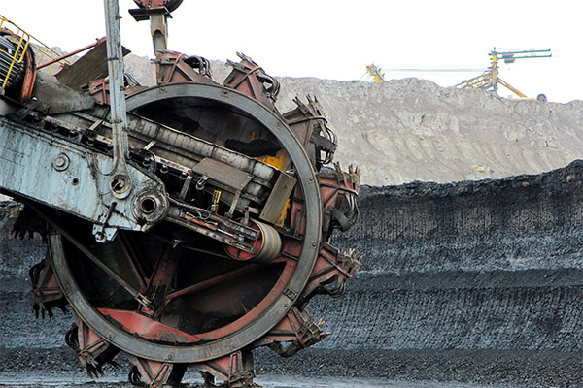
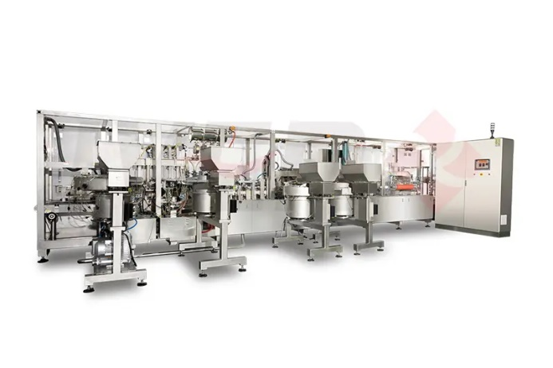
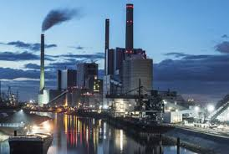
The products offered by Altech cover all industries starting from:
Food industry
Mechanical
Pharmaceutical industry
Mining and energy
Waterpower engineering
Process industry and others

Slide 22
Our satisfied clients:
HBIS Metalac posudje NIS Pančevo
Good Year Coca Cola HBC HIP Petrohemija
Siemens Profitools Interkop
Gorenje ATB Sever TE-TO Skoplje
Toyo Tires Montex Hidromont PMC Automotiv
Kronošpan Konelek Aero Coopertires
Tech Impol Hemofarm
GMB Krušik Tetra Pak Prod.
Hansgrohe T.E. Kostolac Umka
Forma Ideale T.E. Kolubara and many more ...

Slide 23
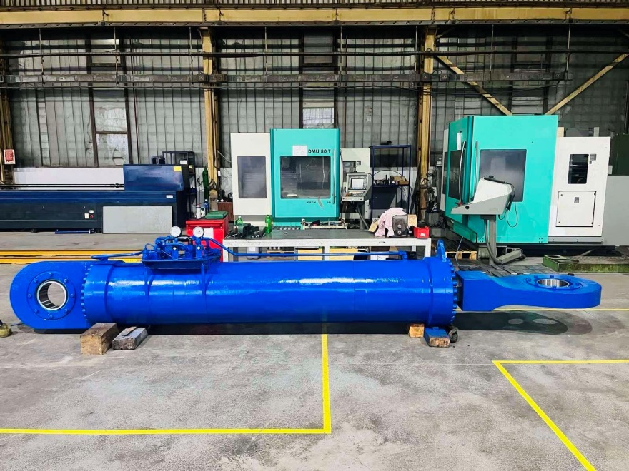

References
EPS (Serbian Electric Power Company)
- The cylinder of the excavator's working wheel hydraulic catarrh, weight 7 t

Slide 24


Hydropower plant in Norway

Slide 25


Cylinder-capsule repair HBIS

Slide 26

Production and installation of hydraulic cylinder - multiplier GRUNDFOS

Slide 27


VBS Copper rolling mill – Hydraulic aggregate

Slide 28




Manufacture of pneumatic system - SRSC Smederevo

Slide 29

AD Plastic - Pneumatic logic

Slide 30


HBIS - GRACO Lubrication system

Slide 31



Zastava oružje - Hydraulic system on sandpaper

Slide 32


MHE Pavlica, Raška - Construction and connection of hydraulic installations of a mini-hydroelectric power plant

Slide 33



Visions and goals of our company
Working better for the well-being of the employees and the satisfaction of users
To remain the market leader in regards to the quality of products from the field of our activity
Constantly using innovations to improve our products

Slide 34

Djure Strugara 16
11300 Smederevo
office@altech.rs
officesd@altech.rs
prodaja1@altech.rs
+381606446490
+381668049920

